Slide 1


RUST SYSTEM PROGRAMMING VULNERABILITIES DETECTION USING DYNAMIC DEBUGGING
PRESENTED BY VISESH BENTULA
TEJA REDDY MANDADI
UMAPATHI KONDURI

Slide 2
TABLE OF CONTENT
Introduction
Background
Dynamic Vs Static Analysis
Datasets Used
Tools Used
Tools Installation and Setup
Safe and Unsafe Code
Tools Output
Results
Conclusion

Slide 3

INTRODUCTION
WHY RUST?
MODERN SYSTEMS PROGRAMMING LANGUAGE
GUARANTEES MEMORY SAFETY, NO NULLS, NO BUFFER OVERFLOWS
ELIMINATES MANY COMMON C/C++ BUGS
BUT…
UNSAFE CODE, FFI, AND CONCURRENCY CAN INTRODUCE VULNERABILITIES
SECURITY BUGS LIKE USE-AFTER-FREE OR DATA RACES CAN STILL OCCUR
PROJECT GOAL:
DETECT AND ANALYZE SYSTEM-LEVEL VULNERABILITIES IN RUST USING DYNAMIC DEBUGGING TOOLS LIKE MIRI, GDB, AND ADDRESSSANITIZER.

Slide 4
BACKGROUND
RUST’S SAFETY MODEL
USES OWNERSHIP, BORROWING, AND LIFETIMES TO ENFORCE SAFE MEMORY ACCESS
MOST CODE IS GUARANTEED SAFE AT COMPILE TIME
WHEN SAFETY BREAKS:
UNSAFE KEYWORD BYPASSES COMPILER CHECKS
FFI (E.G., LINKING TO C CODE) OPENS THE DOOR TO UNSAFE BEHAVIOR
CONCURRENCY INTRODUCES NON-DETERMINISM AND POTENTIAL DATA RACES
DYNAMIC DEBUGGING
RUNTIME ANALYSIS TECHNIQUE
HELPS IDENTIFY BUGS LIKE:
INVALID MEMORY ACCESS
RACE CONDITIONS
UNDEFINED BEHAVIOR
COMPLEMENTS STATIC CHECKS BY CATCHING WHAT THE COMPILER CAN’T

Slide 5
DYNAMIC VS. STATIC ANALYSIS
Limitations of Static Analysis:
Often has "false positives."
Struggles with dynamic code.
Limited on unsafe & FFI.
Strengths of Dynamic Analysis:
Reveals *actual* vulnerabilities.
Shows *concrete* runtime flaws.
Pinpoints errors precisely.
Handles complex code well.
Fewer false positives.
The Complementary Role of Static Analysis:
Static analysis has value in early checks.

Slide 6
DATASETS
Dataset Used
How the Dataset Was Utilized
References
Source: RustSec Advisory Database
Advisory ID: RUSTSEC-2021-0031
CVE ID: CVE-2021-28032
Affected Crate: nano_arena (versions < 0.5.2)
Vulnerability: split_at function allows multiple mutable references, violating Rust's aliasing rules, leading to potential memory safety issues such as out-of-bounds writes and use-after-free. ​RustSec
Analyzed the advisory details from RustSec.
Replicated the vulnerability in a controlled Rust project (nano_arena_vuln).
Demonstrated the unsafe behavior to study its implications.​
RustSec Advisory: RUSTSEC-2021-0031
CVE Details: CVE-2021-28032

Slide 7
split_at() Explanation
The split_at(index) function in Rust is used to divide a slice into two sub-slices at the specified index. The first sub-slice contains elements before the index, and the second contains elements from the index onward.
No data is copied during this operation; both slices reference the original memory.
In this project, split_at_mut(2) was used to obtain two mutable slices:
One containing the first two elements,
Another containing the remaining elements.
This allowed performing operations such as swapping elements across different parts of the original array safely and efficiently.

Slide 8
TOOLS
1
2
3
GDB
AddressSanitizer
Miri
A traditional debugger that lets you step through Rust programs line-by-line, inspect variables, and find where crashes happen.
A runtime tool that catches memory bugs like buffer overflows, use-after-free, and memory corruption as your Rust program runs.
Detect undefined
behavior(like invalid memory accesses, data races) by
interpreting Rust’s Mid-Level Intermediate Representation.

Slide 9
Pre-requisite
Installation Process-GDB
Install MSYS2
Steps:
MSYS2:
Download MSYS2 from msys2.org
2.Open MSYS2 terminal and run:
pacman -Syu
pacman -S mingw-w64-x86_64-gdb
3. Command to launch gdb ./target/debug/unsafe_code
4. I ran the code by:
./target/x86_64-unknown-linux-gnu/debug/unsafe_code
Verify:
gdb --version

Slide 10
Installation Process-AddressSanitizer
Pre-requisite
Rust nightly toolchain
Steps:
Install nightly toolchain:
rustup install nightly
rustup override set nightly
2. Enable AddressSanitizer when building:
RUSTFLAGS="-Zsanitizer=address" cargo run
3. cargo +nightly build -Zbuild-std --target x86_64-unknown-linux-gnu
Verify:
Run program with ASan enabled
Crashes like buffer overflows or UAF will show detailed sanitizer errors automatically

Slide 11
Installation Process-Miri
Pre-requisite
Rust toolchain installed (via rustup.rs)
Steps:
Update Rust toolchain
rustup update
2. Install Miri:
rustup +nightly component add miri
3. Prepared Project by:
cargo +nightly miri setup
4. Run the Code by:
cargo +nightly miri run --bin unsafe_code
Verify:
cargo miri setup
cargo miri run

Slide 12
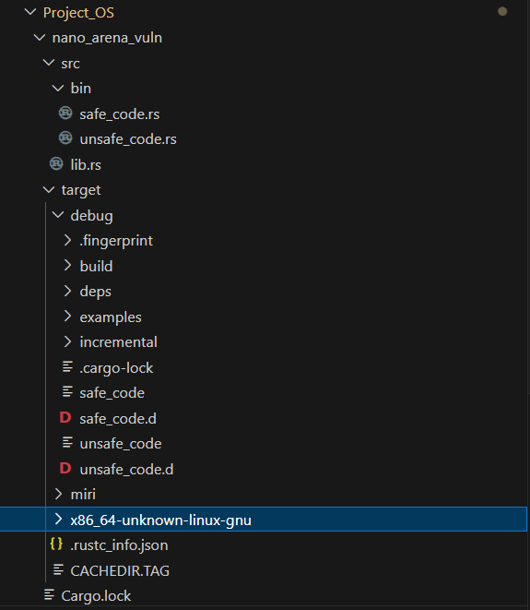
Project Structure

Slide 13
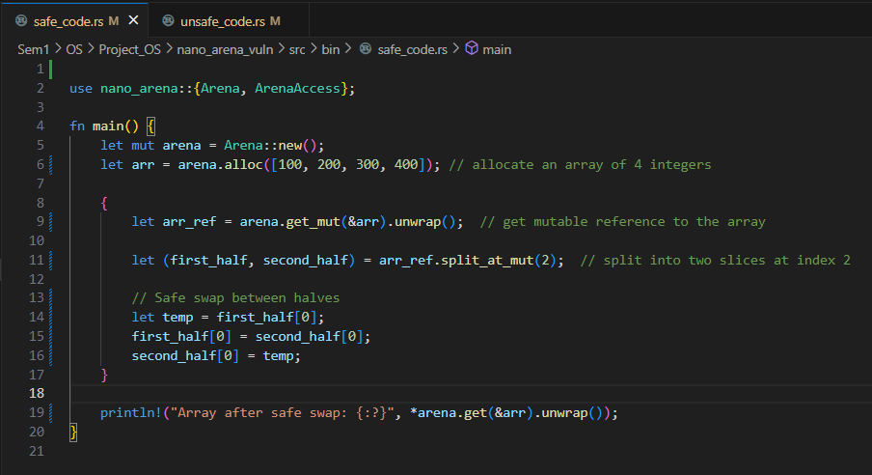
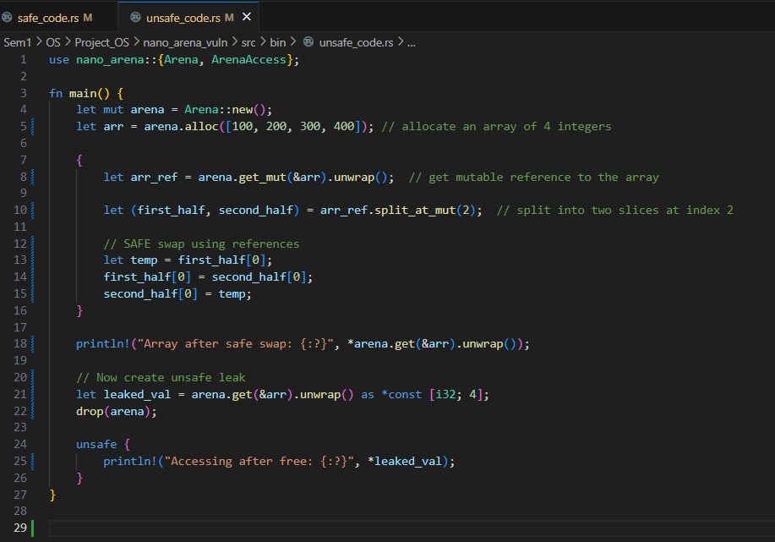
SAFE CODE
Aspect | Safe Code | Unsafe Code
Memory Access | Uses normal references safely. | Uses raw pointers with unsafe.
Pointer Usage | No raw pointers. | Creates and dereferences raw pointers.
Dropping Memory | Rust manages memory safely. | Manual drop and accesses freed memory.
Risk | No risk, fully safe. | Can cause Use-After-Free (UAF) bug.
Who Ensures Safety | Rust compiler ensures it. | Developer must ensure it manually.
UNSAFE CODE

Slide 14
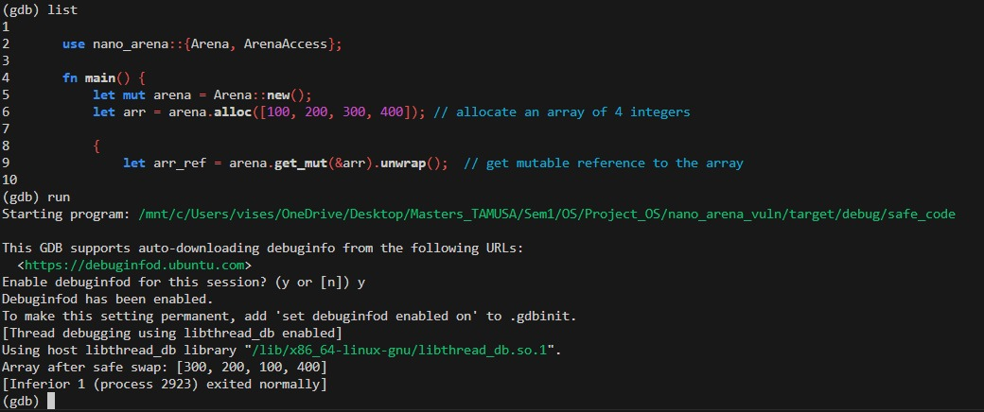
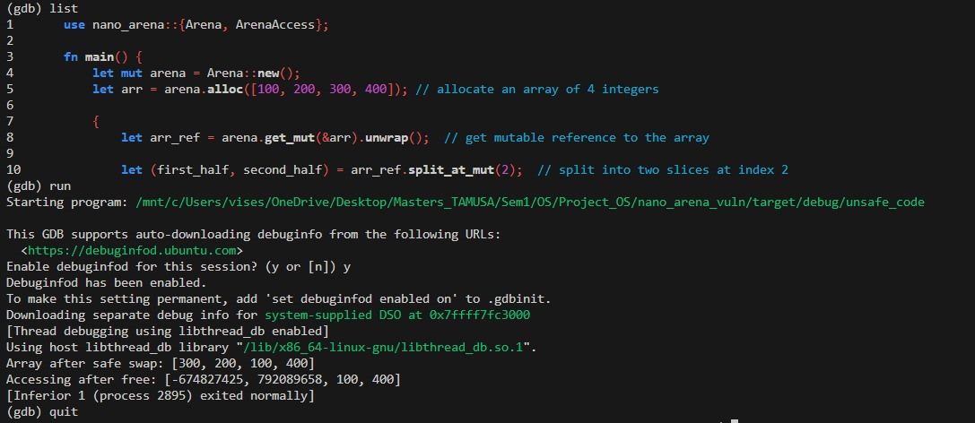
GDB- SAFE CODE OUTPUT
Debugs programs after they crash due to segmentation faults (SIGSEGV).
Program executed until crash at unsafe_code.rs:25.
Shows low-level memory errors after they happen.
Focuses on analyzing memory corruption after the crash occurs.
GDB- UNSAFE CODE OUTPUT

Slide 15
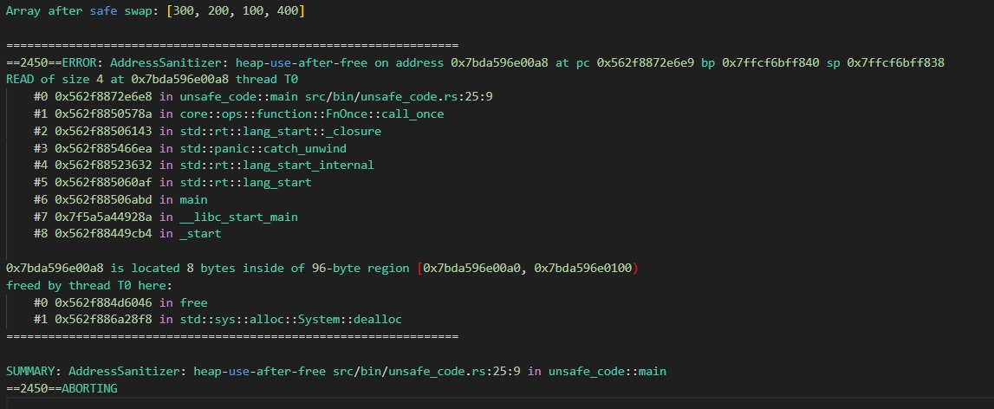
ADDRESSSANITIZER- SAFE CODE OUTPUT
ADDRESSSANITIZER- UNSAFE CODE OUTPUT
Detects Heap memory errors like use-after-free at runtime.
Caught invalid memory access when *leaked_val was dereferenced.
Shows where crash happened (unsafe_code.rs:25) and aborts immediately.
Focuses on dynamic heap issues (malloc/free errors).

Slide 16
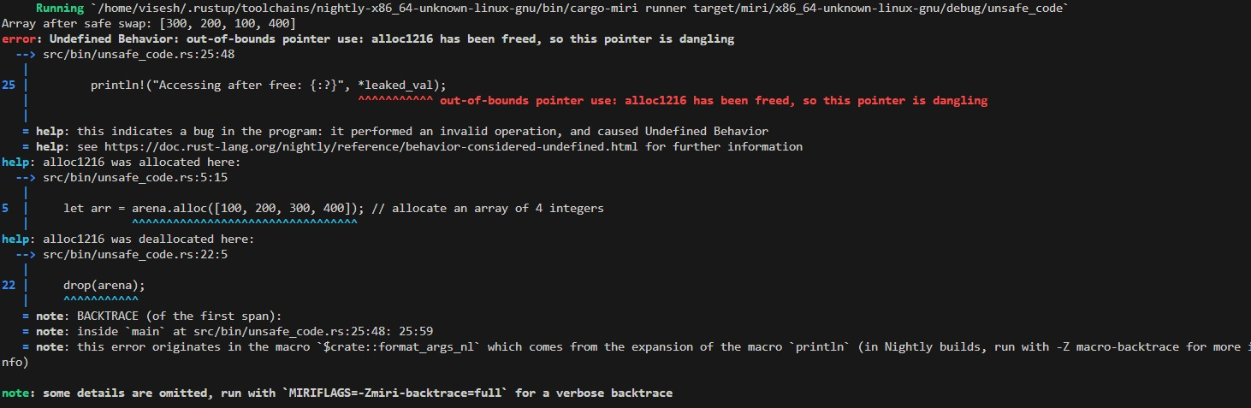
MIRI- SAFE CODE OUTPUT
MIRI- UNSAFE CODE OUTPUT
Simulates program execution to catch undefined behavior early.
Detected dangling pointer dereference during println! at runtime.
Flagged out-of-bounds pointer use at unsafe_code.rs:25.
Focuses on all types of undefined behavior (memory, type errors, stack issues).

Slide 17
RESULTS
Code | ASan result | Miri result | GDB result
safe_code.rs | No bugs detected | No bugs detected | Ran normally
unsafe_code.rs | Detected heap-use-after-free | Detected Undefined Behavior | Crashed after invalid memory access

Slide 18
CONCLUSION
All three tools — ASan, Miri, and GDB — were effective in detecting memory safety issues in Rust code.
ASan was excellent at detecting heap-use-after-free errors with clear reports.
Miri was highly precise for catching undefined behavior during runtime, even for subtle memory errors.
GDB helped identify crashes but was less detailed compared to ASan and Miri.
Overall, Miri is the best tool for detecting subtle memory bugs and undefined behavior in Rust, because it works at the level of Rust’s execution model and catches issues even before they cause a crash.

Slide 19
Q&A

Slide 20
THANK YOU!
🔗 You can explore the complete project on my GitHub:
GitHub Repository: https://github.com/viseshb/Rust-System-Programming-Vulnerabilities-Detection-Using-Dynamic-Debugging
Feel free to check out the code, leave feedback, or contribute!

